Slide 1


JAWAHARLAL NEHRU NEW COLLEGE OF ENGINEERING
Department of Computer Science & Engineering
Shivamogga – 577204
Internship Organization : Rooman Technologies
Data Analytics Intern
Data-Driven Insights into OLA Ride Bookings using Power BI
Presented by:
Suhail D
4JN22CS170

Slide 2
Table of Contents
Problem Statement
Objectives
Dataset Overview
Tech Stack
Data Cleaning
Analysis Process
Ola Insights through Visualization
Visualization Insights
Ola Dashboard (Power BI)
Results
Learning Outcomes
Project Link
Next Steps
Conclusion

Slide 3
1.Problem Statement
In ride-booking platforms like OLA, massive volumes of trip data are generated
daily. However, extracting meaningful insights from this data is challenging.
Traditional reports fail to highlight:
• Peak booking hours
• Revenue patterns
• Ride cancellations
• Demand-supply imbalance

Slide 4
2.Objectives
This project focuses on analyzing OLA ride booking data to extract actionable
insights related to:
• Ride demand patterns
• Revenue generation
• Customer behavior
• Ride status distribution
The goal is to transform raw booking data into meaningful insights using data
analytics and visualization techniques, enabling better operational and strategic decisions.

Slide 5
3.Dataset Overview
Ride demand and booking trends
Revenue and payment analysis
Customer and driver behavior
Ride cancellations and booking status distribution
• Vehicle performance and ride efficiency analysis

Slide 6
4.Tech Stack
Python (Jupyter Notebook) – Data analysis
Pandas, NumPy – Data cleaning & processing
Matplotlib, Seaborn – Data visualization
Power BI – Interactive dashboard

Slide 7

5.Data Cleaning
Converted Order Date column into datetime format
Verified dataset structure (shape, columns, data types)
Checked for missing (null) values
Removed duplicate records
Prepared dataset for analysis

Slide 8

6.Analysis Process
Performed Exploratory Data Analysis (EDA)
Analyzed sales and profit distribution
Compared performance across regions and categories
Studied time-based sales trends
Identified top products and key contributors
Analyzed relationship between discount and profit

Slide 9
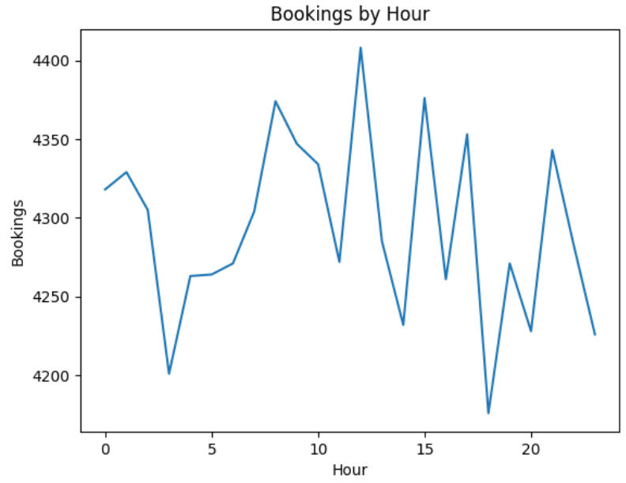
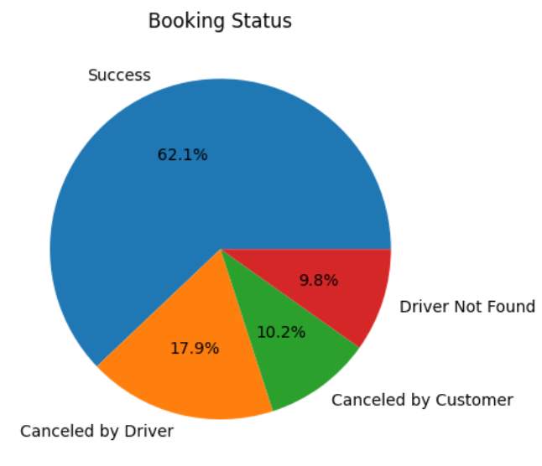
7.Ola Insights through Visualizations

Slide 10
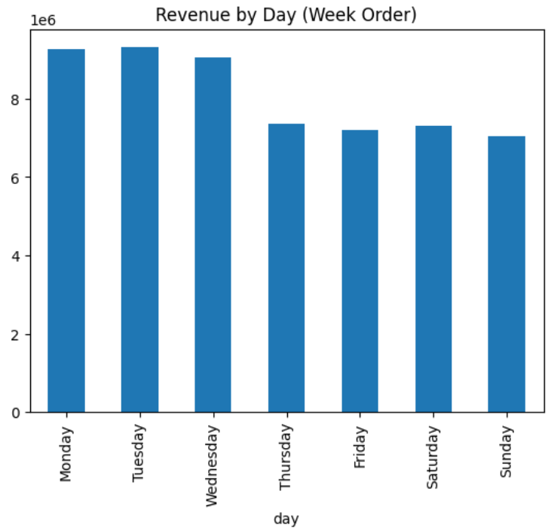
Ola Insights through Visualizations

Slide 11
8.Visualization Insights
Revenue by Day: Monday, Tuesday, and Wednesday generate the highest revenue, while Sunday records the lowest revenue.
Booking Status Distribution: Most rides are successfully completed, while cancellations by drivers are higher than customer cancellations.
Bookings by Hour: Booking demand fluctuates throughout the day, with peak bookings around afternoon and evening hours.
Weekly Revenue Trend: Revenue is stronger during weekdays compared to weekends.
Ride Cancellation Analysis: Driver cancellations contribute significantly to overall failed bookings.
Customer Demand Pattern: Ride demand remains consistent across most hours with slight peaks during busy travel times.
Operational Insight: Higher successful bookings indicate efficient ride management and service availability.
Business Performance Insight: Stable booking volume and revenue trends reflect consistent customer usage of OLA services.

Slide 12
9.Ola Insights Dashboard (Power BI)
The Power BI dashboard provides an interactive overview of OLA ride booking performance using key metrics such as total bookings, booking value, successful rides, cancellations, and customer ratings. It includes visualizations for booking trends, vehicle-type performance, payment method analysis, cancellation reasons, ride volume over time, and customer behavior insights.
The dashboard also includes filters for date-wise analysis, allowing users to explore ride data dynamically across different vehicle types and booking statuses. This helps in identifying booking patterns, monitoring operational performance, analyzing customer satisfaction, and making data-driven business decisions.

Slide 13
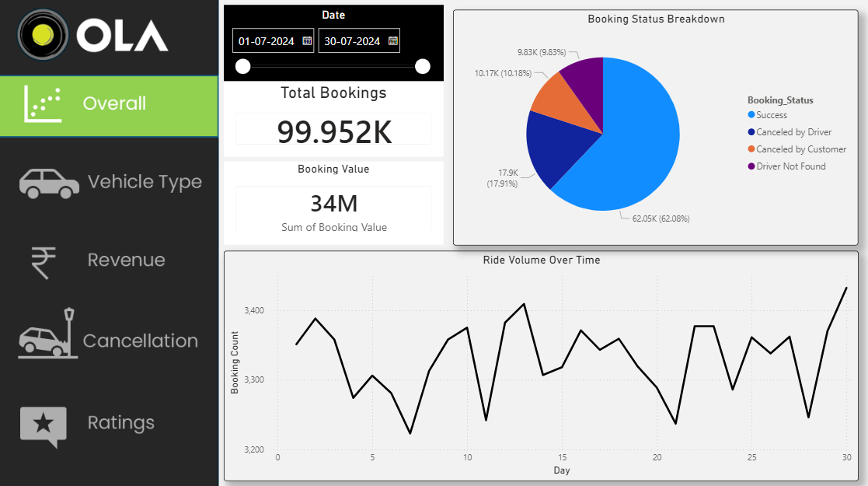
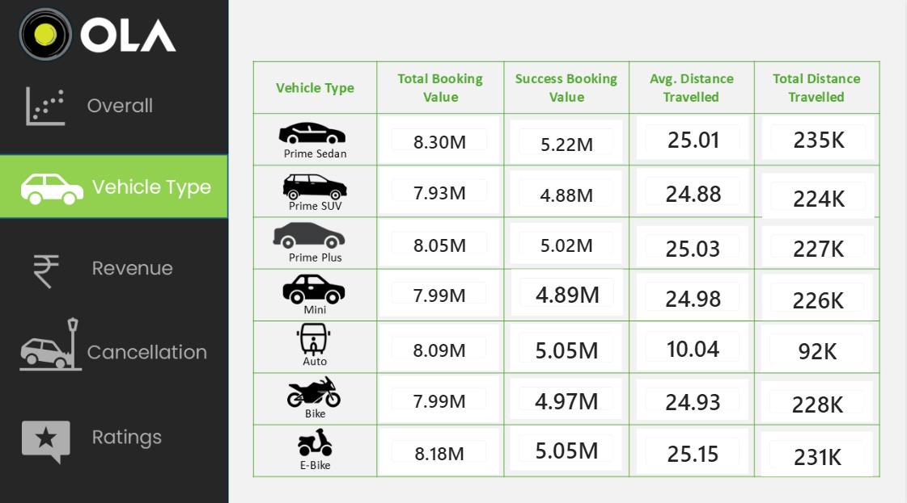
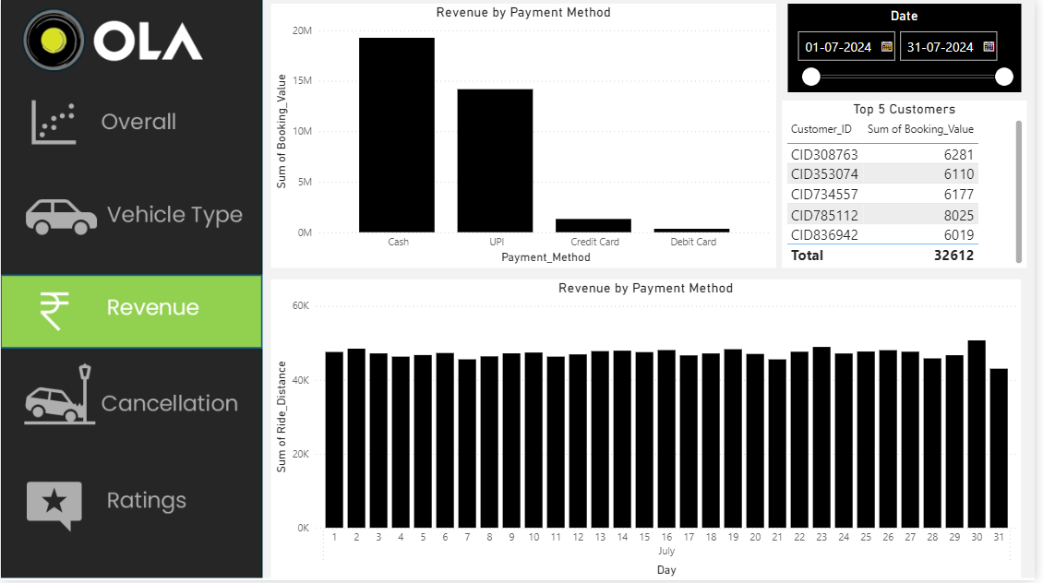

Slide 14
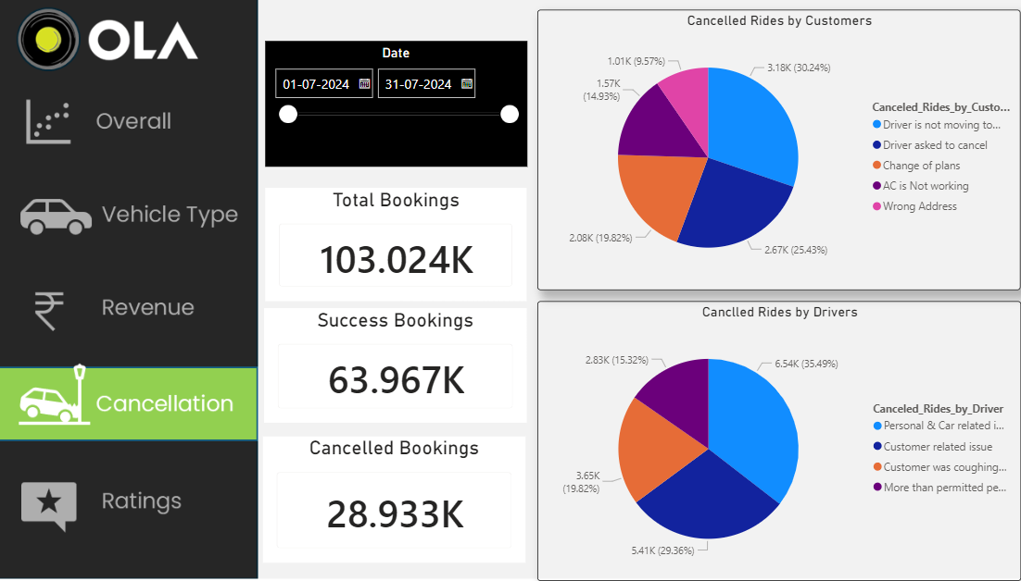
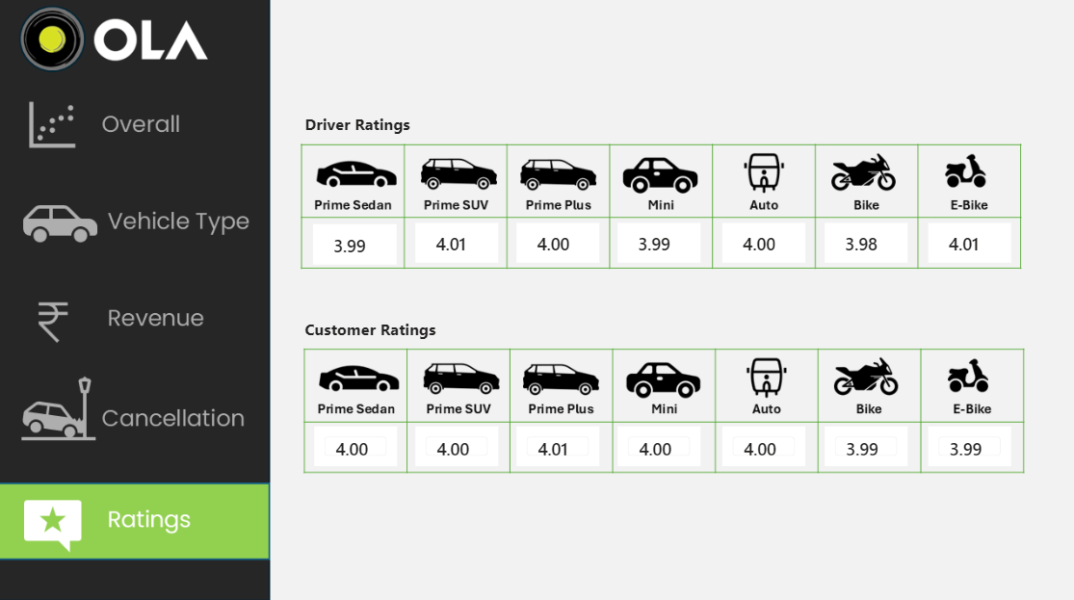

Slide 15
10.Results
The analysis of the OLA booking dataset revealed several important business insights. Successful rides accounted for the majority of total bookings, indicating efficient ride management and strong service performance. Among vehicle types, Prime Sedan and E-Bike generated high booking values, showing strong customer preference for these services.
The analysis also highlighted that driver cancellations were higher than customer cancellations, which may affect customer satisfaction and operational efficiency. Payment method analysis showed that Cash and UPI contributed the highest share of revenue compared to card payments. Additionally, ride demand varied across different days and hours, with higher booking activity observed during weekdays and peak travel hours.

Slide 16
11.Learning Outcomes
Gained understanding of data cleaning and preprocessing techniques using OLA booking data
Learned Exploratory Data Analysis (EDA) to identify ride demand, cancellations, and revenue trends
Improved data visualization skills using charts, graphs, and interactive reports
Developed interactive dashboards using Power BI for booking and revenue analysis
Analyzed customer behavior, ride patterns, and vehicle-type performance
Understood how data analytics helps improve operational efficiency and business decision-making in ride-hailing services

Slide 17
12.Project Link
1.GitHub (Notebook + Power BI):
https://github.com/Suhaild43/Ola_Project

Slide 18
13.Next Steps
Integrate real-time booking data for live ride and revenue analysis
Apply predictive analytics to forecast ride demand and peak booking hours
Enhance the dashboard with more interactive filters and advanced visualizations
Improve customer and driver insights using machine learning models
Develop route and demand optimization features for better operational efficiency
Implement automated alerts for cancellations, low ratings, and service issues
Expand analysis to include traffic, weather, and location-based ride patterns

Slide 19
14.Conclusion
This project successfully demonstrates how raw OLA booking data can be transformed into meaningful insights using data analysis and visualization techniques. By analyzing ride bookings, revenue, cancellations, customer behavior, and vehicle performance, important trends and operational patterns were identified.
The dashboards provide an interactive and clear view of booking performance, ride demand, cancellation reasons, payment methods, and customer satisfaction. These insights help in understanding business trends, identifying operational challenges, and supporting better decision-making. Overall, the project highlights the importance of data analytics in improving service efficiency and customer experience in ride-hailing platforms.
This project shows how data analytics can help ride-hailing businesses make smarter and more efficient decisions.

Slide 20

Thank You

